Slide 1
SAS Interview Presentation
Maurice M. Materise

Slide 2
Tools
Github
Python
Flask
Javascript
JQuery
Bootstrap

Slide 3
Initial Assumptions
Data Format
Use Case
I used a JSON format with key value pairs for employee details.
The object is simply to just view which employees have birthdays in a select month. HR would want results in a UI, not from a command line result.
Data is Valid
I did not include error checks on the data received. I would expect the error checking to occur on data input.

Slide 4
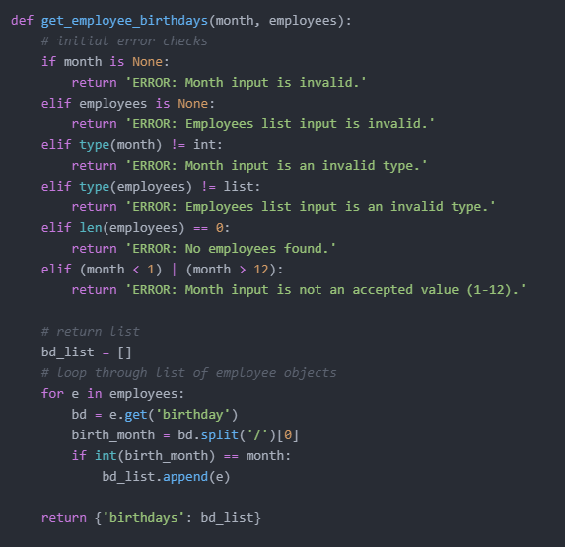
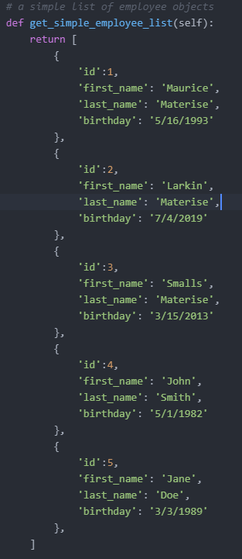
Solution
Example data:
Code: https://github.com/materimm/SAS/blob/main/employees.py

Slide 5
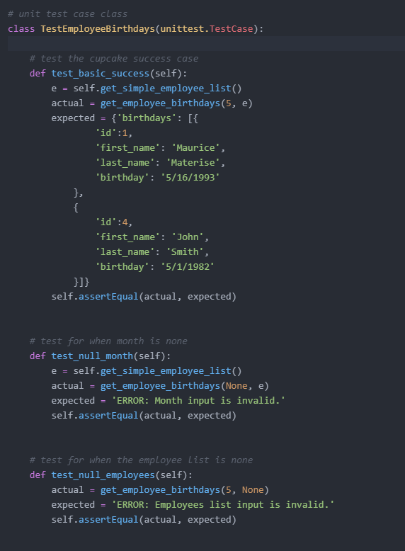
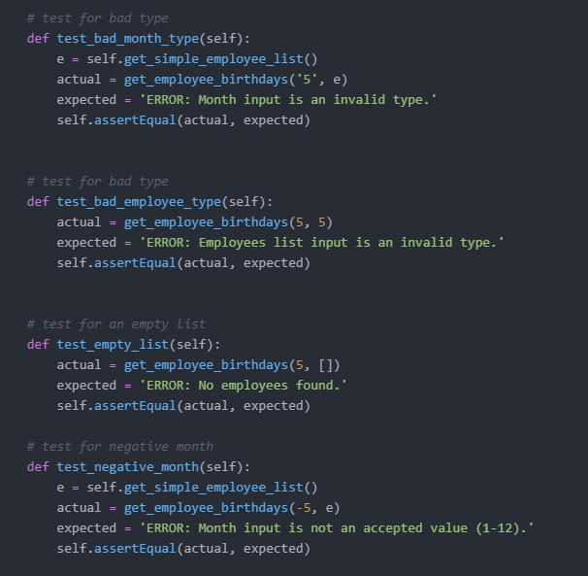
Test Cases
Basic success
Null month
Null employee list
Bad month type
Bad employee type
Empty employee list
Negative month value
Test case library: unittest

Slide 6
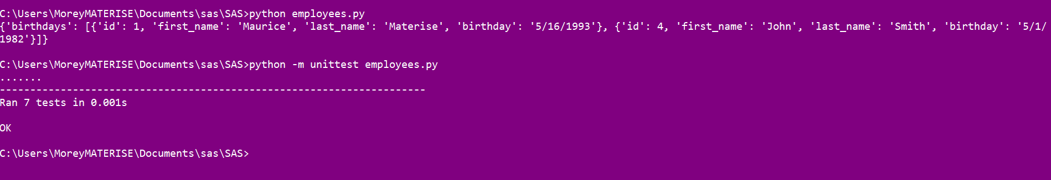
Example Results

Slide 7
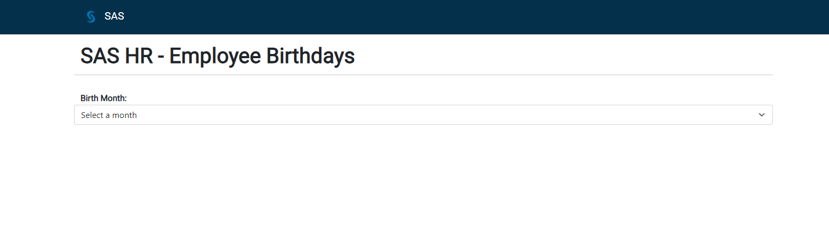
User Interface

Slide 8
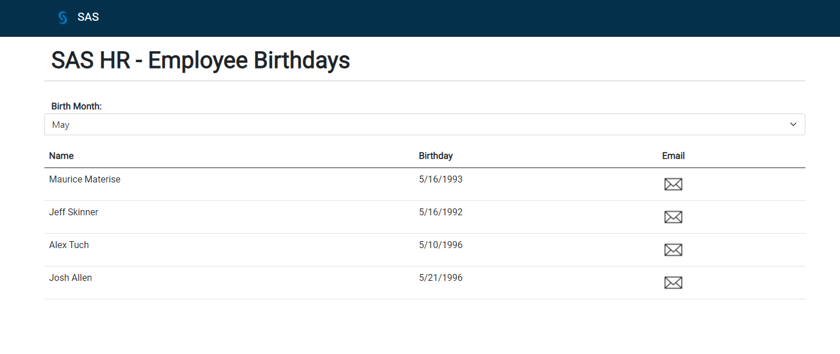
User Interface

Slide 9
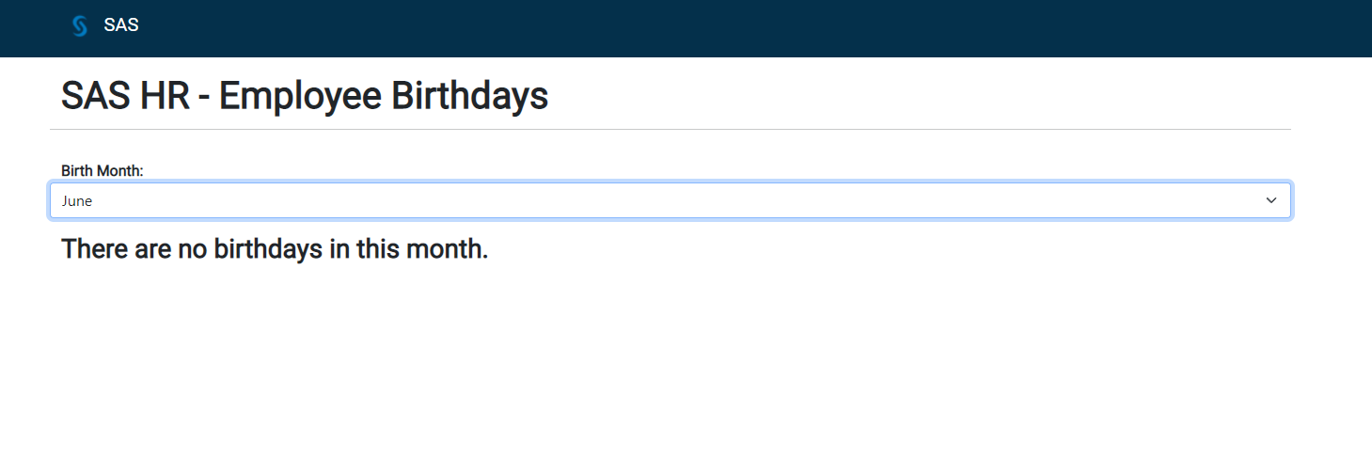
User Interface

Slide 10
Challenges
User Problem
Use Case
Data
Errors to check
What is the problem to solve?
What is the use case for the solution?
Lack of stakeholder feedback
Where is the data?
Data format
Bad keys, wrong birthday format
Database injection from UI

Slide 11
Links
Full Code Base: https://github.com/materimm/SAS/blob/main/employees.py LinkedIn: https://www.linkedin.com/in/maurice-materise-72301575/

Slide 12
THANK YOU
Maurice M. Materise
716-796-5849
mmaterise@gmail.com

